Slide 1
Neural Network Methods in Natural Language Processing
Ch7 Case Studies of NLP Features
吴晨 延浩然

Slide 2
Motivation
Now explore examples of concrete NLP classification tasks, and suitable features for them
We want to make sure that the network we design can make effective use of the available signals
By giving it direct access to them by use of feature-engineering
By designing the network architecture to expose the needed signals
By adding them as an additional loss signals when training
Notes:
在上一章讨论过NLP问题中的特征后，这一章来看一些实际的例子
在实际问题中考虑特征的处理的原因是我们想要确保设计的网络能有效地利用可用信号
要么通过特征工程的介入使得网络能够直接利用这些信号
要么通过设计特定的网络结构来暴露所需的信号
要么在训练模型的时候把它们作为新加入的损失信号

Slide 3
Outline
Document Classification
Language Identification
Topic Classification
Authorship Attribution

Slide 4
Document Classification: Language Identification

Slide 5
Document Classification: Language Identification
Language Identification
given a document or a sentence, classify it into one of a fixed set of languages.
Bag-of-letter-bigrams
Each possible letter-bigram (or appearing at least k times) is a core feature
The value is the count of that feature in the document
Notes:
语言识别任务的定义是，给出一个文档或一句话，将它分类到一个固定的语言集合中去。
字母上的bigrams 是这一任务的一个很强的特征表示
具体的，每个可能的字母二元组（或者每个至少出现K次的字母二元组）是一个核心特征，它的value 是这个文档中的该特征的出现次数

Slide 6
Document Classification: Topic Classification

Slide 7

Document Classification: Topic Classification
Topic Classification
given a document, classify it into one of a predefined set of topics
Sports
Politics
Gossip
Economy
Notes:
主题分类的任务是，给定一篇文档，将其分类到一个预先定义好的主题中去 （比如说 经济、政治、体育、娱乐、闲聊、生活方式、其他）

Slide 8
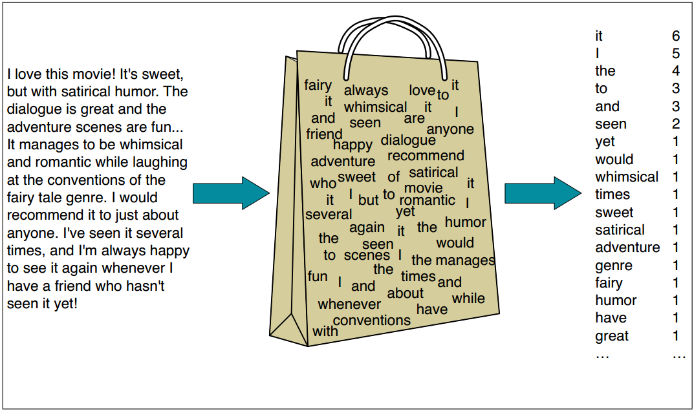
Document Classification: Topic Classification
Topic Classification
Letter level words
Word order is not very informative
Core feature: bag-of-words, bag-of-word-bigrams
Notes:
这里，字母级别的特征不是很有信息量，那么我们的基本单元应该转为词
在这个任务中，词序也不是很重要的特征，因此较好的特征是文档的词袋，可以由二元词袋模型实现

Slide 9
Document Classification: Topic Classification
If we don’t have many training examples
Pre-processing the document
Replace each word with its lemma
Supplement distributional features
Word clusters
Word-embedding vectors
Notes:
下面说明了一些实际使用中出现的情况
如果我们没有很多训练样本的时候，
我们可以前处理文档，将每个词替换成它的原型的形式，防止训练集的偏差
我们也可以通过distributional features 来补充特征，比如词聚类和word-embedding 向量

Slide 10
Document Classification: Topic Classification
When using a linear classifier
May want to consider word pairs
Will result in a huge number of potential core features
Design some heuristic to decrease it
Nonlinear classifiers alleviate this need
Notes:
使用线性分类器时，我们可能想考虑词对，比如考虑出现在同一篇文章中的一对词来作为核心特征
这会导致潜在核心特征的数量巨大，可以通过设计一些启发式的算法来减少这一特征的数目，比如只考虑出现在了特定数目的文档中的词对。
非线性分类器减轻了这一需求

Slide 11
Document Classification: Topic Classification
Sometimes it’s useful to weight each word
using like TF-IDF
然而，学习算法经常能自己学出权重
Another option is to use word indicators instead of word counts
Notes:
当使用词袋模型时，成比例地衡量其信息量十分有用 , 比如用TF-IDF
然而，学习算法经常能自己学出权重 ， 可以取代上述特征
另一观点是使用词指示器而不是词的数目
也就是1代表出现，0代表不出现，而不是词的出现次数
这在具体的应用中会有不同的考量

Slide 12
Document Classification: Authorship Attribution
Notes:
文档分类： 作者风格归属

Slide 13
Document Classification: Authorship Attribution
Authorship Attribution
Given a text, infer the identify of its author(from a fixed set of possible authors)
Or other characteristics of the author, such as their gender, their age or their native language
Very different from topic classification
Clues are subtle
stylistic properties vs. content words(实词)
Notes:
在这一任务中，给出一篇文章我们需要推测它的作者身份（从一个固定的可能的作者集合中），或者推测作者的其他特征，比如他们的性别，他们的年龄或者他们的母语
用来解决这一任务的特征和主题分类的十分不同—— 线索是微妙的， 并且包含文章的文体属性而不是实词。

Slide 14
Document Classification: Authorship Attribution
Good features: POS tags and function words(虚词)
“On, if, the, and, before”
Pronouns like “he, she, I, they” as well
A good approximation:
The list of top-300 most frequent words in a large corpus
We could capture subtle stylistic variation in writing via these features
Notes:
因此我们选择特征需要避开实词并关注更多的文体属性。
词性标签和虚词是对于这一任务而言比较好的特征，
这些词 比如 on,if,the,and ,before 之类的 这些词它们本身没有携带过多的内容信息，
但却担负着着连接那些承载内容的词
并将这些内容分发出去的任务，
像是代词 比如说 he,she ,I ,they 也是一样的。
虚词的一个较好近似是前300 个在大语料中出现最频繁的词。
通过聚焦于这些特征，我们能够学习捕捉写作中的微妙文体变化，这对于一个作者来说是独一无二的并且很难作假的。

Slide 15
Document Classification: Authorship Attribution
Good features for this task
Bag-of-funtion-wirds-and-pronouns
Bag-of-POS-tags
Bag of POS bigrams, trigrams, 4grams
Additionally
Density of function words
A bag of bigrams of function words after removing the content words
The distribution of the distance between consecutive function words
Notes:
总结一下 作者风格归属的任务
的一个好的特征集合包括虚词和代词的词袋，
词性标注特征的词袋，
以及二元、三元和四元的词性标签词袋。
另外，在实际的使用中，我们可能还会考虑虚词的密度（比如在一个滑动窗口中 虚词的数目除以实词的数目而得到的比率） ，
取出实词之后的二元功能词袋，以及连续的虚词之间的距离的分布.

Slide 16
Word in context : Part of Speech Tagging
Notes:
文档分类： 作者风格归属

Slide 17
Word in context : Part of Speech Tagging
Given a sentence, assign the correct POS to each word
Universal Treebank Project (17 tags)
Structured task:
Classify each word based on a window of 2 words each side
Regard as an isolated classification task
Intrinsic cues (word) & Extrinsic cues (context)
identity, prefix, suffix, orthographic shape, frequency
identity, prefix, suffix, POS prediction
Notes:
the tag of the first word may depend on the tag of the third one
此处 prefix 和 suffix算是重复 feature，但是可以用来辅助预测OOV word

Slide 18
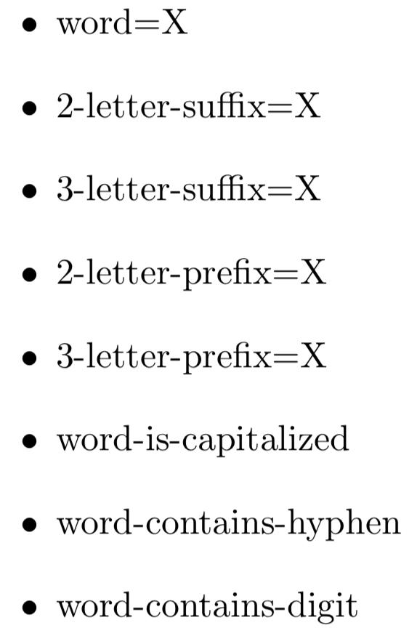
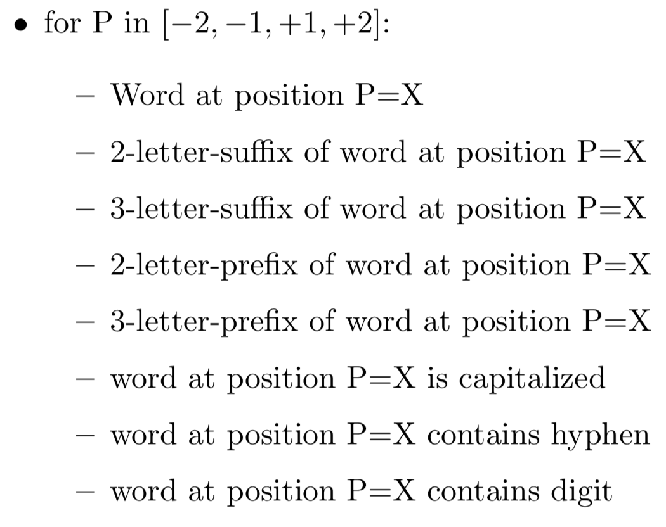
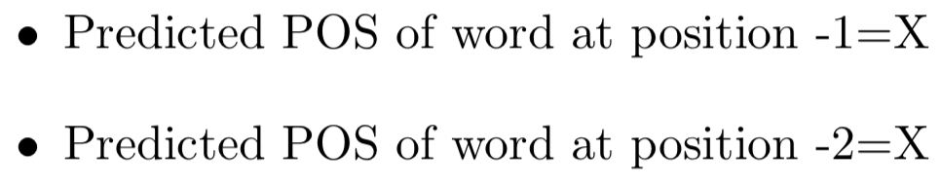
Word in context : Part of Speech Tagging
Notes:
distributional information such as word clusters or word-embedding vectors of the word and of surrounding words can also be useful

Slide 19
Word in context : Named Entity Recognition
Notes:
文档分类： 作者风格归属

Slide 20
Word in context : Named Entity Recognition
Given a sentence, find named entities and categorize them
PERSON, ORGANIZATION, LOCATION, OTHER
Context dependent task
Milan (LOCATION? ORANIZATION?)
Sequence tagging task

Slide 21
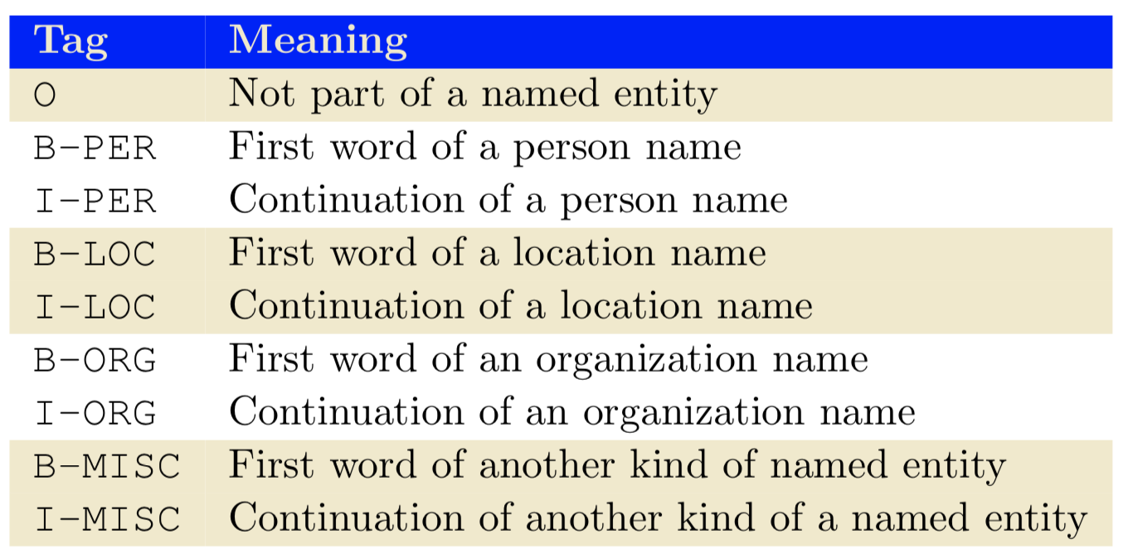
Word in context : Named Entity Recognition
John Smith , president of McCormik Industries visited his niece Paris in Milan , reporters say .
John/B-PER Smith/I-PER ,/O president/O of/O McCormik/B-ORG Industries/I-ORG visited/O his/O niece/O Paris/B-PER in/O Milan/B-LOC ,/O reporters/O say/O ./O

Slide 22
Word in context : Named Entity Recognition
Tagging decisions for different words interact with each other
Core feature: same as POS task
Distributional features such word clusters or word vectors are also extremely useful for the NER task

Slide 23
Word in context, Linguistic Features: Preposition Sense Disambiguation
Notes:
文档分类： 作者风格归属

Slide 24
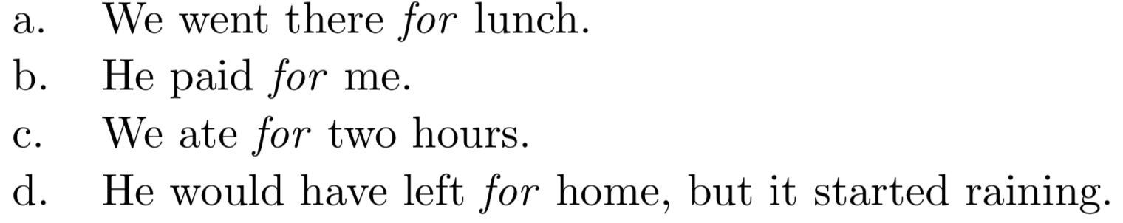
Word in context, Linguistic Features: Preposition Sense Disambiguation
Notes:
a.目的 b.收益 c.时间 d.地点

Slide 25
Word in context, Linguistic Features: Preposition Sense Disambiguation
Assign the correct sense to a preposition in context
fixed window around features?
Not informative, even misleading

Slide 26
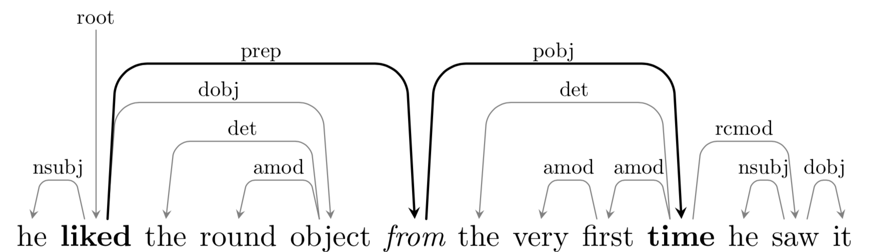
Word in context, Linguistic Features: Preposition Sense Disambiguation
heuristic feature: capture the governor and the and object of the preposition
“the first verb on the left” and “the first noun on the right”
more rules ? use a dependency parser !
the governor and object information is easily readable from the syntactic tree, reducing the need for complex heuristics
Notes:
the parser used for producing the tree may be wrong too. For robustness, we may look at both the governor and object extracted from the parser and the governor and object extracted using the heuristic

Slide 27
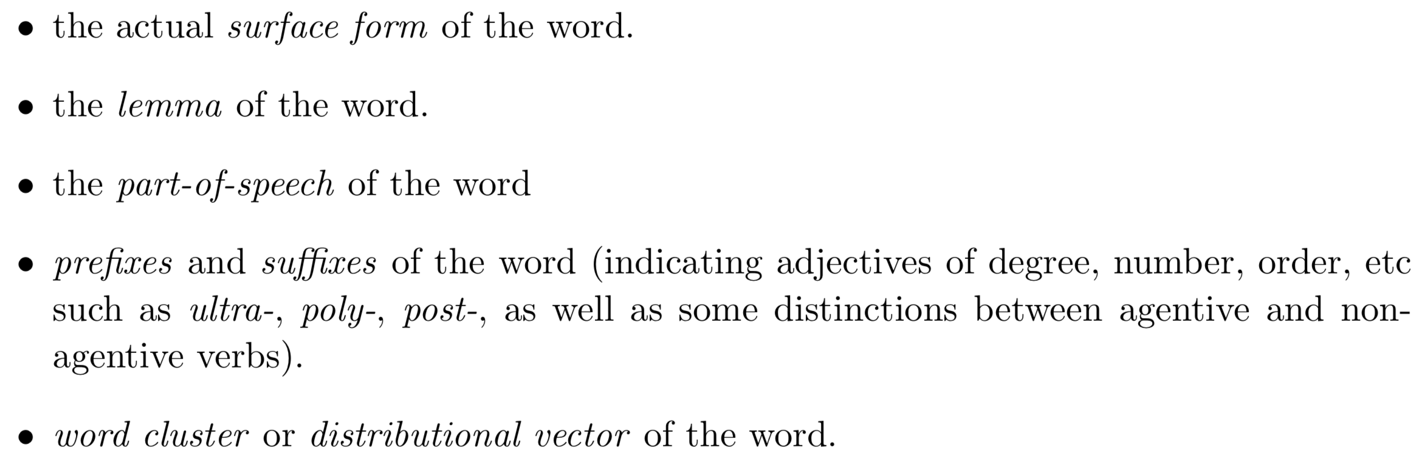
Word in context, Linguistic Features: Preposition Sense Disambiguation
Further features after extracting the governor and the object
Notes:
A lemma is the word you find in the dictionary
If we allow the use of external lexical resources and don’t mind greatly enlarging the feature space, Hovy et al. [2010] found the use of WordNet based features to be helpful as well.
The preposition-sense disambiguation task is an example of a high-level semantic classification problem, for which we need a set of features that cannot be readily inferred from the surface forms, and can benefit from linguistic pre-processing (i.e. POS-tagging and syntactic parsing) as well as from selected pieces of information from manually curated semantic lexicons.

Slide 28
Relation Between Words in Context: Arc-Factored Parsing
Notes:
文档分类： 作者风格归属

Slide 29
Relation Between Words in Context: Arc-Factored Parsing
one approach to modeling the dependency parsing task
n² word-word relations (arcs), each assigned a score
search for the valid tree with the maximal overall score
trained scoring function ArcScore(h,m,sent)
h: index of the candidate head-word
m: the index of the candidate modifier
Notes:
Training the scoring function such that it works well with the search procedure will be discussed in chapter 19. Here, we focus on the features used in the scoring function.

Slide 30
Relation Between Words in Context: Arc-Factored Parsing
features in scoring function
The word form (and POS-tag) of the head word.
The word form (and POS-tag) of the modifier word.
Words (POS-tags) in a window of two words to each side of the head word, including the relative positions.
Words (POS-tags) in a window of two words to each side of the modifier word, including the relative positions.
consider feature combination when using linear classifier
Notes:
Word-forms give us very specific information
parts-of-speech provide lower level syntactic information that is more generalizable
supplement or replace the words using distributional information, in the form of word clusters or pre-trained word embeddings
We do not look at prefixes and suxes of words, because these are not directly relevant to the parsing task. (already in POS)

Slide 31
Relation Between Words in Context: Arc-Factored Parsing
also informative to consider
the distance between words w_{h} and w_{m} in the sentence
the direction between the words.
all the words (POS-tags) of words that appear between the head and the modifier
Notes:
Word-forms give us very specific information
parts-of-speech provide lower level syntactic information that is more generalizable
supplement or replace the words using distributional information, in the form of word clusters or pre-trained word embeddings
We do not look at prefixes and suxes of words, because these are not directly relevant to the parsing task. (already in POS)

Slide 32
谢谢！

